Slide 1
UNIX Essentials
UNIX Utilities & Shell Programming
Module 2

Slide 2
Agenda
1
Unix Utilities
2
I/O Redirection
3
Filters & Pipes
4
Shell Programming

Slide 3
Objectives
At the end of this module you will be able to:
Make use of commonly used utilities
Understand and take advantage of I/O redirection
Combine filters using pipes, to perform complex operations
Understand the purpose of shell
Write shell scripts

Slide 4
Unix Utilities

Slide 5
Unix Utilities
Unix has rich set of utilities for programmers, administrator and end users.
Utilities that are covered in this module are
  cat
  echo
  gzip
  tar
  grep
  egrep

Slide 6
cat
The cat command stands for concatenate, reads files either from standard input or those specified on command line and prints the contents on the screen.
It can be used to
  view contents of a file
  concatenate contents of multiple files
  create a file
cat always sends its output to the standard output (by default console)
Examples
  $ cat /etc/passwd displays contents of /etc/passwd
  $ cat test.h test.c displays contents of test.h followed by test.c
  $ cat reads stdin and writes to the stdout
  $ cat abc - pqr read file abc, then stdin, followed by file pqr

Slide 7
cat command options
Some of the commonly used options
-n display line number
-b display line number for non-blank lines only
-s squeeze multiple adjacent blank lines
$ cat -n data
1 line-1
2 line-2
3 line-3
4
5
6 line-4
7 line-5
8 line-6
$
$ cat -b data
1 line-1
2 line-2
3 line-3
4 line-4
5 line-5
6 line-6
$
$ cat –s –n data
1 line-1
2 line-2
3 line-3
4
5 line-4
6 line-5
7 line-6
$

Slide 8
echo
The command echo, is a built-in command of shell.
Its purpose is to output its arguments on to stdout.
Examples
$ echo hello
hello
$ echo abc xyz
abc xyz
$ echo abc xyz
abc xyz
$ echo "abc xyz"
abc xyz
Note the difference in argument & output

Slide 9
gzip command
gzip command is used to compress a file
  The file is replaced with the compressed file
  Compressed file is given .gz suffix
options
  -c --stdout → write output to standard output
  keeps original file unchanged
  -d → creates uncompressed file. Compressed file is removed
  -v → verbose

Slide 10
gzip – examples
$ ls –l backup
-rw-rw-r-- 1 wipro18 wipro18 1071 Apr 19 12:21 backup
$
$ gzip backup
$ ls -l backup*
-rw-rw-r-- 1 wipro18 wipro18 1101 Apr 19 12:21 backup.gz
$ gzip -d backup
$ ls –l backup*
-rw-rw-r-- 1 wipro18 wipro18 1071 Apr 19 12:21 backup
$ ls -l x*
-rw-rw-r-- 1 wipro18 wipro18 474 Apr 17 19:52 x1
-rw-rw-r-- 1 wipro18 wipro18 36 Apr 22 16:00 x.c
$ gzip -v x*
x1: 57.6% -- replaced with x1.gz
x.c: -5.6% -- replaced with x.c.gz
$ gzip -v -d x*
x1.gz: 57.6% -- replaced with x1
x.c.gz: -5.6% -- replaced with x.c

Slide 11
tar command
tar (abbreviation for tape archive) command is used to
  archive files
  extract files from archive
  update archive
tar command options
  c create archive
  t list files in the archive (just like ls command output)
  x extract files from archive
  u update archive [adds only those files which are newer]
  The above options are mutually exclusive and can be combined with other options of the tar command, such as
  f <filename> specifies the name of the output file
  z use zip or gzip to compress
  v provide verbose output

Slide 12
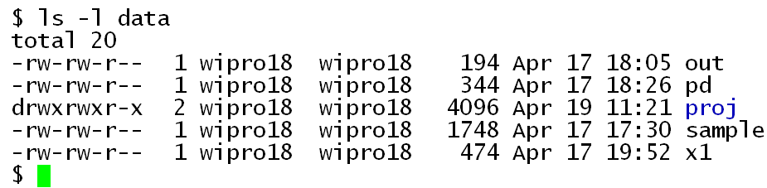
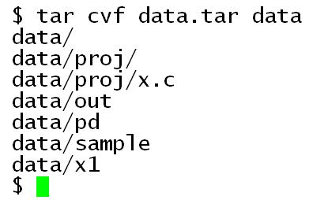
tar examples – creating archive
Consider the files to be archived in the directory “data”
An archive of the directory “data” is created with the file named “data.tar” using tar command.

Slide 13
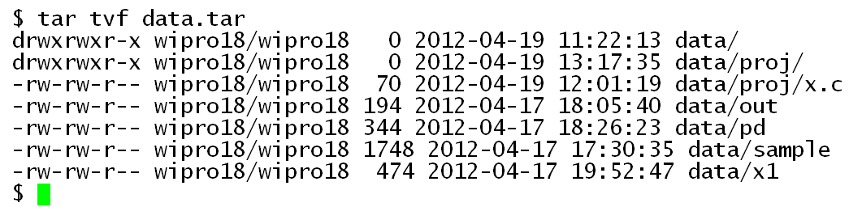
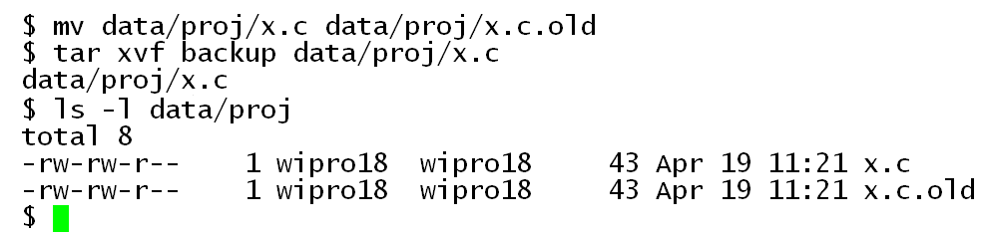
tar examples – viewing & extracting
Viewing an archive using tvf options
Rename x.c file, then extract x.c from the archive using xvf options.

Slide 14
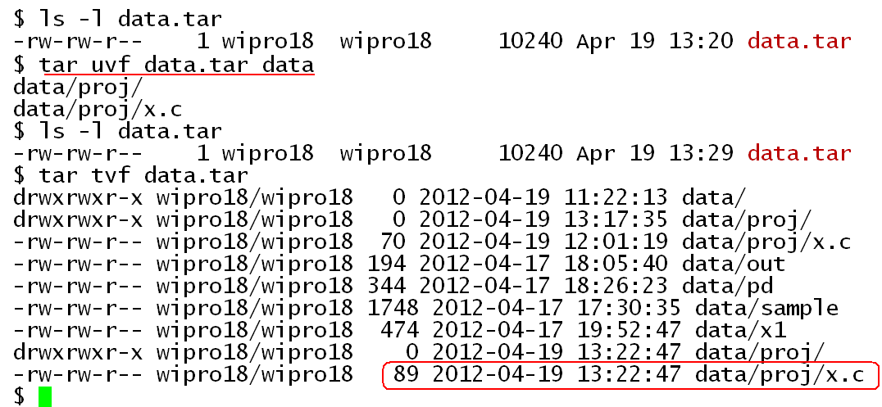
tar examples – updating
Update the archive using option u.

Slide 15
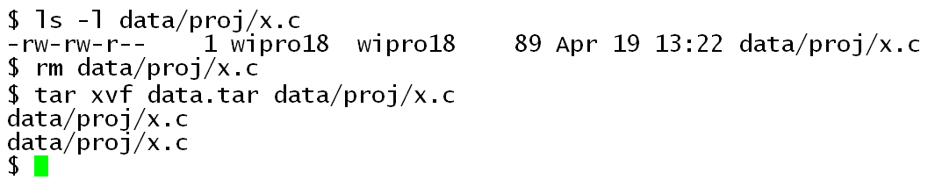
tar examples – updating (Contd.).
Extract file x.c from the archive.
Note that two versions of x.c are extracted. The latest version is the one extracted last.

Slide 16
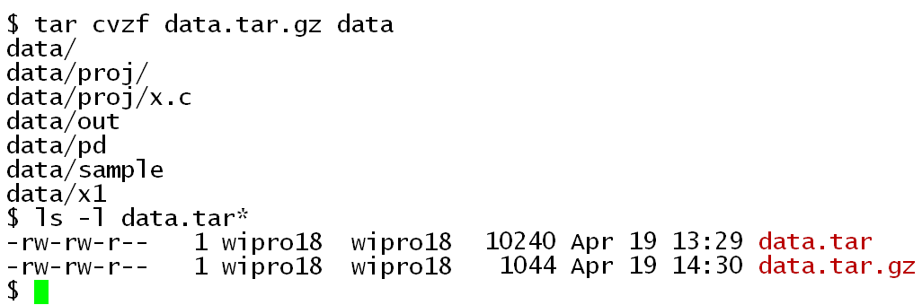
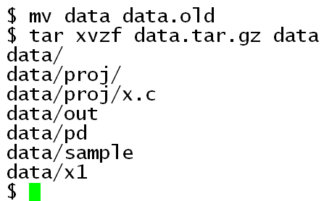
tar examples – creating a compressed archive
Add option z (lower case) to create a compressed tar file.
Add option z (lower case) to extract from a compressed tar file.
In this example, directory “data” is renamed and recreated by extracting the folder and files from the compressed archive.

Slide 17
Regular expressions
Regular expression is a sequence of characters (i.e., a string) Apart from alpha numeric characters, it can include special characters
  A regular expression with special characters, represents a pattern of strings
Regular expressions are used in the context of pattern matching, with utilities such as vi, grep, tr.

Slide 18
Regular expressions (Contd.).
Special character | Matches with | Example
. | any one character | .at can match strings like cat, bat, rat, etc.
[ ] | With any single character within the set | [cb]at can match with strings cat and bat, but not with rat
* | Zero or more characters | *.c any string that ends with .c [aeiou]* any string that begins with a vowel
[^ ] | Any character other than the set of characters specified in [ ] -- complemntary set | [^aeiou]* any string that does not begin with a vowel
^ | Line that begin with the pattern | grep “^#” x.c Lists lines that begin with #
$ | Line that end with the pattern | ls – l | grep “.c$”

Slide 19
grep
grep searches specified files and extracts lines matching the criteria specified as arguments
grep [options] pattern [file .... ]
Options can be
-i ignore case
-v other than the lines containing the pattern
-c print the count of matches or non-matches (in case of –v option)
-n print line number
-E interpret pattern as extended regular expression

Slide 20
grep – examples
Examples
  $ ls -l | grep –c "^d" prints the number of sub-directories
  in the current directory
  $ ls -l | grep –v "^d" prints details of all files, other than directories
  $ grep -i '^a...a$' /usr/share/dict/words
  prints 5 letter words that begin and end with a

Slide 21
egrep
egrep (extended grep) is more powerful than grep.
It allows to search for pattern-A or pattern-B
Example
  $ ls -l /dev | egrep "^c|^b"
  the pattern "^c|^b” indicates, lines beginning with c or b.
  The command prints details of character and block device files.
  $ ls -l /dev | grep -E "^c|^b"

Slide 22
I/O Redirection

Slide 23
I/O Redirection
By default some utilities read from standard input, if no file is specified.
Most often programs write output only to standard output (screen)
Some times need arises where input and/or output need to be redirected from/to a file.
File descriptor | Default Target
0 | Standard input (keyboard)
1 | Standard output (screen)
2 | Standard error (screen)

Slide 24
I/O Redirection (Contd.).
Shell provides special symbols for this purpose.
Symbol | Meaning | Example
> out | “out” is considered as output file instead of screen | $ ls –l > out
< abc | “abc” is considered as input file instead of keyboard | $ cat < abc
2> out.err | Redirect error to specified file out.err | $ ls –l > out 2 > out.err
m>&n | Merge output of descriptor m with that of n | $ ls –l > out 2>&1

Slide 25
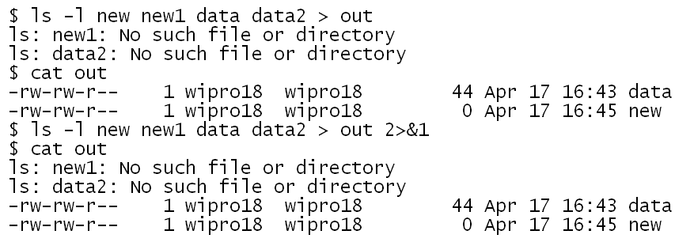
I/O Redirection – more examples
$ cat < abc
This is equivalent to
$ cat abc
$ cat abc > xyz
This is equivalent to
$ cp abc xyz

Slide 26
Filters & Pipes

Slide 27
Filters
Filter is a program that accepts a stream of data, processes and produces output onto the standard output.
  If no input file is specified, it takes data from standard input
Filters are used to process text data and produce output according to a criteria.
Each filter is designed to serve a specific purpose
Examples
  cat → concatenation of files
  grep → extract lines from a file containing or not containing a pattern
  sort → sort data according to specified criteria
  head → print first N lines of a file
  tail → print last N lines of a file
  cut → extract column(s) of text from a file

Slide 28
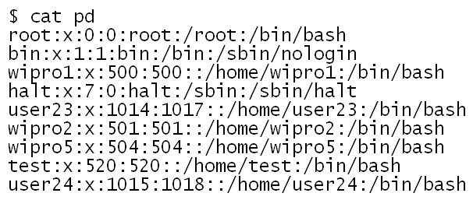
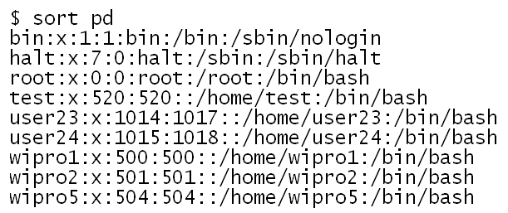
sort – examples
Sort on user name
sort, without any option sorts in ASCII order

Slide 29
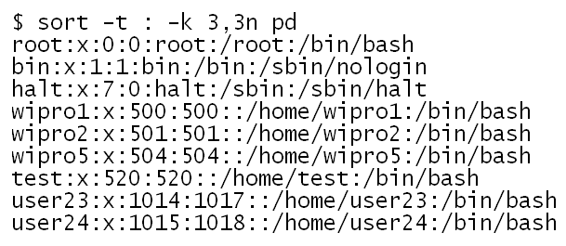
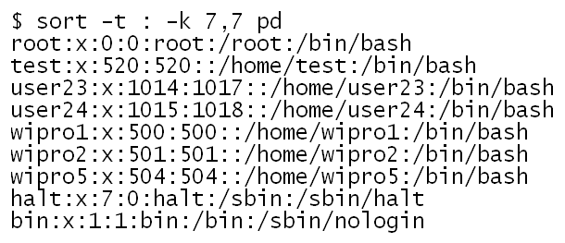
sort – examples (Contd.).
Sort on single field
Sort on user id
Sort on shell name

Slide 30
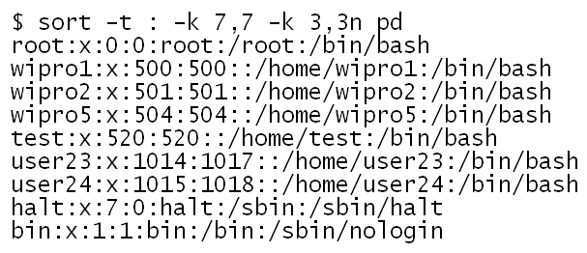
sort – examples (Contd.).
Sorting on multiple fields
Sort on shell name & user id

Slide 31
head
The command head is useful to print few lines from the beginning of a file or standard input.
If no option is specified by default, head outputs first 10 lines.
One or more filenames can be given on the command line
Examples
  $ head /etc/passwd prints first 10 lines of /etc/passwd
  $ head -20 /etc/passwd prints first 20 lines of /etc/passwd
  Alternately
  $ head -n 20 /etc/passwd prints first 20 lines of /etc/passwd

Slide 32
Head (Contd.).
The option –q is useful when multiple files are specified, to suppress the filename as header for each output.
$ head -5 data1 data2
==> data1 <==
line-1
line-2
line-3
line-4
line-5
==> data2 <==
text-1
text-2
text-3
text-4
text-5
$
$ head -5 -q data1 data2
line-1
line-2
line-3
line-4
line-5
text-1
text-2
text-3
text-4
text-5
$

Slide 33
tail
The command tail is useful to print the last few lines of a file or standard input.
If no option is specified by default, tail outputs last 10 lines.
One or more filenames can be given on the command line
Examples
  $ tail /etc/passwd prints last 10 lines of /etc/passwd
  $ tail -20 /etc/passwd prints last 20 lines of /etc/passwd
  Alternately
  $ tail -n 20 /etc/passwd prints last 20 lines of /etc/passwd

Slide 34
Pipes
At times, a single filter is insufficient to meet a requirement.
It is possible to chain filters in a sequence such that output of one filter can be fed as input to another filter.
This is achieved using pipe operator ( | ).
ex:
  $ ls -l | grep “^-” | wc -l
  what is the purpose of above command sequence?
Advantages of pipe
  No need to create temporary files and cleanup after use
  Readability
[Note: wc command prints count of lines, word and characters of the input

Slide 35
tail
Unlike, head, the command tail provides + option, that allows to output from n^{th} line to the end of file.
$ cat -n data1 | tail +3
3 line-3
4 line-4
5 line-5
6 line-6
7 line-7
8 line-8
9
$

Slide 36
tee
A filter sends output to standard output only.
If another command is piped to a filter, the output of command before the pipe gets redirected as input to the next command in the pipe chain. Therefore, it can not be saved into a file.
tee command provides the facility to forward the output to standard output, as well as save the output into a file
    $ cat -n data | tee data-ln | tail + 3
cat -n data
tail +3
cat -n data
tee data-ln
tail +3
data-ln

Slide 37
tr
The tool tr is a fllter, which either translates or deletes characters based on a criteria.
tr translates characters identified in set1 into set2, which are strings of characters
tr [options] [set1] [set2]
Some commonly used options
-d delete the characters specified in set1
-s squeeze, each successively repeated character is replaced
with only single occurrence
Note: tr does not take filename. It only reads standard input.

Slide 38
tr – examples
$ cat abc | tr a-z A-Z > abc.up
replaces lowercase alpha with uppercase.
$ ls –l | tr -s ' '
squeezes spaces in between columns into single space
$ cat /etc/passwd | tr ":" "#"
outputs /etc/passwd contents with : replaced by #

Slide 39
cut
The command cut, extracts a column of text from input file.
If the input text is delimited by a character, w.r.to that delimiter, the text can be considered as having multiple fields.
Space is the default delimiter.
Options
-d delimiter specifies delimiter, by default space
-f field list restricts output to only these fields

Slide 40
Cut (Contd.).
root:x:0:0:root:/root:/bin/bash
bin:x:1:1:bin:/bin:/sbin/nologin
daemon:x:2:2:daemon:/sbin:/sbin/nologin
adm:x:3:4:adm:/var/adm:/sbin/nologin
lp:x:4:7:lp:/var/spool/lpd:/sbin/nologin
sync:x:5:0:sync:/sbin:/bin/sync
shutdown:x:6:0:shutdown:/sbin:/sbin/shutdown
$ cut -d : -f1,4 /etc/passwd
root:0
bin:1
daemon:2
adm:4
lp:7
sync:0
shutdown:0

Slide 41
Shell Programming

Slide 42
Bash Shell Programming
Topics covered are
  Purpose of Shell
  Flavors of shell
  Features of Bash shell
  Variables – built-in and userdefined
  set & unset of variables
  Exporting variables
  Configuring shell – use of /etc/profile and .profile
  Exit status of a command executed
  Command execution in background
  Positional parameters to shell script
  Using constructs – for, while, if, case, test

Slide 43
About Bash Shell
Purpose of Bash Shell
  Provides interface to the operating system
  Shell is command interpreter
Apart from being command interpreter, bash has the following features
  Command history
  Command alias
  Command editing
  Programming language
  Arrays

Slide 44
Flavours of Shell
Name | Executable command | Remarks
Bourne shell | sh | The original shell of UNIX Designed by Steve Bourne of Bell Labs
C shell | csh | Shell developed Univ. of California, Berkeley C-like language
TC shell | tcsh | C shell with emacs style editing of commands
Korn Shell | ksh | Designed by David Korn of Bell Labs
Bourne again shell | bash | Enhanced version of Bourne shell. Default shell with Linux variants

Slide 45
quotes
Shell provides three different types of quotes, as shown below:
Name | Example | Remarks
' ' (single quote) | $ echo '$HOME' $HOME | No processing of special symbols
" " (double quote) | $ echo "$HOME" /home/wipro1 | Variable substitution
` ` (back quote) | $ cwd=`pwd` $ echo $cwd /home/wipro1 | Executes the string within back quotes considering it as a command. Mostly used inside shell scripts to capture output into a variable for further processing.
\ (backslash) | $ echo \'$HOME\' '$HOME' | Suppress the special meaning

Slide 46
Shell variables
Shell variables are classified as
  Environment variables
    Variable on which execution behaviour of an application depends
    To create an environment variable use export command
  User-defined variables
    These are defined by programmer for a specific purpose
    Usage is limited to shell script in which it is defined and used.
  Built-in or predefined variables
    These are variables defined as part of the shell. Some examples :-
      BASH → provides path to the bash binary
      HOME → represents home directory for logged in user
      PS1 → primary prompt
      PS2 → secondary prompt
      $$ → process id of the shell in execution
      $? → exit value of last command
      $# → count of positional parameters
      $0, $1 …. $9 → positional arguments

Slide 47
Some environment variables & values
BASH=/bin/bash
HISTFILE=/home/wipro18/.bash_history
HISTFILESIZE=1000
HISTSIZE=1000
HOME=/home/wipro18
IFS=$' \t\n‘
LOGNAME=wipro18
PATH=usr/local/bin:/bin:/usr/bin:/home/wipro18/bin
PROMPT_COMMAND='echo -ne "\033]0;${USER}@${HOSTNAME%%.*}:${PWD/#$HOME/~}\007"'
PS1='[\u@\h \W]\$ '
PS2='> '
PS4='+ ‘
SHELL=/bin/bash
SHLVL=1
TERM=xterm
UID=517
USER=wipro18

Slide 48
Defining and removing variables
A variable is introduced into the current shell, by assigning value to a variable
$ NAME=John
Contents of a variable can be printed using echo command
$ echo $NAME
John
A shell variable exists till it is removed using unset command
$ unset NAME
$ echo $NAME
$
There should not be spaces
on either side of = sign
After unset, echo displays no output for the shell variable

Slide 49
Exporting a variable
A variable defined in a shell will not be accessible to a subshell.
$ NAME=John
$ echo $NAME
John
$ bash
$ echo $NAME
$
Create a subshell within the current shell
A variable can be exported to make it accessible to subshells.
Two different ways of exporting a variable is shown below.
$ export NAME=John
$ echo $NAME
John
$ bash
$ echo $NAME
John
$
$ NAME=John
$ echo $NAME
John
$ export NAME
bash
$ echo $NAME
John
$

Slide 50
Configuring Bash shell
Shell environment can be configured or personalized.
The following files influence the behaviour of the shell.
/etc/profile
  Configuration for the entire system, not user specific
$HOME/.bash_profile
  Contains user specific configuration of the shell environment
  This file is processed each time user logs-in
/etc/bash.bashrc
  Sets environment variables
$HOME/.bashrc
  User preferences for environment variables
  This file is called by $HOME/bash_profile
  This internally calls /etc/bash.bashrc

Slide 51
Bash built-in variables
Name | Purpose | Remarks
PS1 | Primary prompt | This prompt is provided for the user to issue the Unix commands. On complete execution of the given command, the prompt is displayed again.
PS2 | Secondary prompt
PATH | Directories to search for executable files
TERM | Terminal type | man
$ echo "hello
> world"
hello
world
Secondary prompt

Slide 52
Checking exit status of a command
At times it is necessary if a command executed by the shell was successful or not.
Bash shell provides a special predefined variable $? which contains the exit status of the last command
Following is the convention followed for exit status
    0 → command executed successfully
    1 → command not executed successfully
Most commands follow the above convention
$ ls -l t1
-rw-rw-rw- 1 wipro18 wipro18 0 Apr 24 12:20 t1
$ echo $?
0
$ ls -l t2
ls: t2: No such file or directory
$ echo $?
1

Slide 53
Command execution in background
Shell facilitates applications to be run in background.
Criteria for running an application in background is
  Application does not require input from user (i.e., non-interactive)
  Takes reasonable time to complete
To execute a program in background mode, use & (ampersand) symbol at the end of the command.
When a command is initiated to run in background, the shell returns immediately, with the process id of the background process.
Note: it is user’s responsibility to ensure that the program run in background would not read from standard input and writes to standard output.
$ ls –lR / > filelist 2>&1 &
12074
$

Slide 54
Aliases
Aliases provide an alternate name to a command (with options if any) that is executed at command line.
Aliases can be defined on a command line or inside a shell script
Alias is defined in the following way
  alias aliasname= 'command'
Following aliases are defined by /etc/bashrc
  alias l.='ls -d .* --color=tty'
  alias ll='ls -l --color=tty'
  alias ls='ls --color=tty'
Take note that command should be enclosed in single quotes

Slide 55
Aliases – examples
The following alias introduces the command upper, which outputs uppercase equivalent of the input.
$ alias upper='tr a-z A-Z‘
$ echo "Change lower to UPPER"
Change lower to UPPER
$ echo "Change lower to UPPER" | upper
CHANGE LOWER TO UPPER
The following alias introduces the command dir, which prints directories in the current directory.
alias dirs='ls -l | grep "^d"'

Slide 56
Positional parameters to a shell script
It is possible to pass arguments to shell scripts, and mechanism exists to refer to the arguments within a shell script using built-in variable to process positional parameters
    $0 → command name
    $1 → 1st argument
    $2 → 2nd argument
    …
    $9 → 9th argument
    $# → number of arguments

Slide 57
Positional parameters to a shell script (Contd.).
$ cat printargs
echo arg count = $#
echo \$0 = $0
echo arg[1] = $1
echo arg[2] = $2
echo arg[3] = $3
$
$ ./printargs abc xyz pqr
arg count = 3
$0 = ./printargs
arg[1] = abc
arg[2] = xyz
arg[3] = pqr
$
$ ./printargs abc xyz
arg count = 2
$0 = ./printargs
arg[1] = abc
arg[2] = xyz
arg[3] =
$

Slide 58
Positional parameters to a shell script
$ ./printargs New Delhi Tokyo New York
arg count = 5
$0 = ./printargs
arg[1] = New
arg[2] = Delhi
arg[3] = Tokyo
$
$ ./printargs "New Delhi" Tokyo "New York"
arg count = 3
$0 = ./printargs
arg[1] = New Delhi
arg[2] = Tokyo
arg[3] = New York
$
Arguments with embedded spaces need to be enclosed in double quotes

Slide 59
Command substitution
At times output of a command is required to be saved in a variable for further processing.
Two ways in which output of a command can be saved in a variable
$ date1=`date`
$ echo $date1
Mon Apr 12 11:53:43 IST 2010
$ date2=$(date)
$ echo $date2
Mon Apr 12 11:55:16 IST 2010

Slide 60
read command
Lets read from standard input
Quite useful in shell scripts to accept data
Example
$ read name
Peter
$
$ echo $name
Peter
$

Slide 61
while construct
Syntax for while loop
while [ condition ]
do
commands
done
Example
#! /bin/bash
#filename : cat1.sh
while read line
do
echo $line
done

Slide 62
while construct – examples
Reading contents from standard input, like cat
Reading contents from a file like cat
#! /bin/bash
#filename : cat2.sh
while read line
do
echo $line
done < $1
Usage:
$ ./cat2.sh new.c
#! /bin/bash
#filename : cat1.sh
while read line
do
echo $line
done

Slide 63
for construct
Syntax for for loop
$ for k in 1 2 3
> do
> echo $k
> done
1
2
3
$
for arg in [ list ]
do
command(s)
done
Note: It is possible to execute simple logic as shown above from command line.
It is not necessary to have the script in a file

Slide 64
for construct – examples
$ ls
data data1 out pd proj sample
$
$ for k in `ls`
> do
> echo $k
> done
data
data1
out
pd
proj
sample
$
Note: ls in back quotes.
Output of ls becomes the list through which for loop iterates.

Slide 65
Two special positional variables
While $1, $2 etc represent specific positional argument, $* and $@ represent all arguments.
These can be used in the following manner
  $@
  “$@”
  @*
  “$*”
Of the above four possible usages, only “$@” considers the arguments the way it is expected to be

Slide 66
for construct – examples
Processing arguments using for loop
for item in $@
do
echo $item
done
echo "=============="
for item in "$*"
do
echo $item
done
echo "=============="
for item in "$@"
do
echo $item
done
#! /bin/bash
# file: args.sh
for item in $*
do
echo $item
done
echo "=============="

Slide 67
for construct – examples (Contd.).
$ ./args.sh New Delhi London New York
New
Delhi
London
New
York
==============
New
Delhi
London
New
York
==============
New Delhi London New York
==============
New
Delhi
London
New
York
$ ./args.sh "New Delhi" London "New York"
New
Delhi
London
New
York
==============
New
Delhi
London
New
York
==============
New Delhi London New York
==============
New Delhi
London
New York

Slide 68
Logical expressions
Logical expression can be put in one of the following ways
1) test expression
2) [ expression ]
3) (( expression ))
In case of 3), expression has C-like syntax
Ex: (( a == b )) (( a != b ))
test is a built-in command of bash

Slide 69
Logical expressions (Contd.).
For the following two forms
test expression
[ expression ]
Arithmetic conditional expression is of the form
a cond-operator b
where arithmetic conditional operator can be :-
-lt -le -gt -ge -eq -ne
Test expression for strings
S1 = S2 tests if equal
S1 != S2 tests if not equal
S test if S is not zero length
-n S test if S is not zero length and exists
-z S test if string is zero length and exits
To test file attributes, expression will be of the form
-s file tests if file exists and not empty
-f file tests is ordinary file and exists
-d file test if file is a directory
-r file test if file is readable and exists
-w file test if file is writable and exists
-x file test if file is executable and exists

Slide 70
while loop
Syntax for while loop
while condition
do
commands
done
Example
#! /bin/bash
#filename : cat1.sh
while read line
do
echo $line
done

Slide 71
if construct
Syntax for if construct
if condition
then
commands
fi
Syntax for if - elif construct
if condition
then
commands
elif condition
then
commands
else
commands
fi

Slide 72
if construct - example
#! /bin/bash
#filename : filetype.sh
if [ -f $1 ]
then
echo "$1 non-empty file"
elif [ -d $1 ]
then
echo "$1 directory"
else
echo "$1 unknown file"
type
fi

Slide 73
case construct
#! /bin/bash
# filename: mex.sh
if (( $# != 3 ))
then
echo insufficient arguments
exit 1
else
case "$2" in
"+") (( result = $1 + $3 )) ;;
"-") (( result = $1 - $3 )) ;;
*)
echo invalid operator $2
esac
echo $result
fi
exit 0
$ ./mex.sh 3 + 2
5
$ ./mex.sh 3 - 2
5
$ ./mex.sh 3 / 2
Invalid operator /
$

Slide 74
Example
Compute the sum of numbers given as argument to the shell script.
#! /bin/bash
# file: sum
sum=0
while [ $# -gt 0 ]
do
sum=`expr $sum + $1`
shift
done
echo sum = $sum
expr is an external command that can be used to perform arithmetic operation.
Space on either side of the operator is a must
shift command shifts positional parameters to the left by one position, except the command itself (i..e., $0)
$ sum 5 7 9 12
$0 $1 $2 $3 $4
After executing shift,
sum 7 9 12
$0 $1 $2 $3
After executing shift again
sum 9 12
$0 $1 $2

Slide 75
Hands-on and Assignments

Slide 76
Exercises
Assuming the file abc exists and has some content, what would happen when the following command is executed?
$ cat abc > abc
Run the following commands in the given sequence, and check the contents of the files out1 and out2.
$ touch data
$ touch new
$ ls -l new new1 data data1 2>&1 > out1
$ ls -l new new1 data data1 > out2 2>&1
What is the observation made?
Get the names of files, directories and subdirectories in the root directory into the file named files-under-root. The file should not contain any error messages associated with directories that could not be opened.

Slide 77
Exercises (Contd.).
Compress files in the current directory, and then uncompress the files.
Create a tar file for all the files whose name begin with any of the characters a to k (both inclusive)
Print file attributes (in ls –l format), of all the character and block device files in /dev directory.
List files whose file name is exactly 5 characters, from the current directory.
List all the files from the root directory and its subdirectories captured into a file. Any errors with respect to file access should be simply ignored, not to be part of output.

Slide 78
Exercises (Contd.).
Sort /etc/passwd file on the basis of login shell.
Print the name of the largest file in the current working directory.
Write a shell script named mid which takes three arguments
lineN lineM filename
and prints the lines lineN to lineM from the specified file.
Print the names of users for whom there is no login shell.
[ Hint: such users will have the login shell specified as /bin/nologin ]

Slide 79
Summary
In this module, we discussed
use of commonly used utilities
Understand and take advantage of I/O redirection
Combine filters using pipes, to perform complex operations
Understand the purpose of shell
Write shell scripts

Slide 80
Review Questions
How to display lines of a file along with line numbers?
Which command option is used to extract a file from a tar file.
What does the expression 2 >&1 represent?
Give example for a filter utility?
Which command is useful to extract a column of text from a text file?
How to export a variable in Bash shell?
What is the difference between grep and egrep?
What is the advantage of alias?
What does $# represent in Bash shell?

Slide 81
References
Richard Petersen, Linux The Complete Reference. Ed 6. New Delhi: McGraw-Hill Education India, 2007.
Eric Foster-Johnson, John C. Welch, and Micah Anderson, Beginning Shell Scripting, Indianapoli: Wiley Publishers Inc, 2005.
Sander Van Vugt, Beginning the Linux Command Line, Wrox Press, 2005.

Slide 82
Thank You

